Slide 1





01
Data Project : June oral Presentation
Bouchez Hugo, Guilliams Laurie, Lemoine Estelle

Slide 2


Motivations
02
We are interested in the cinema.
Nowadays, films of all genres, all nationalities and with all types of actors are released every month.
There are many websites that classify and rate these films, but on what basis?

Slide 3

Question we are insterested in
03
Can you predict the rating of
upcoming movies ?

Slide 4
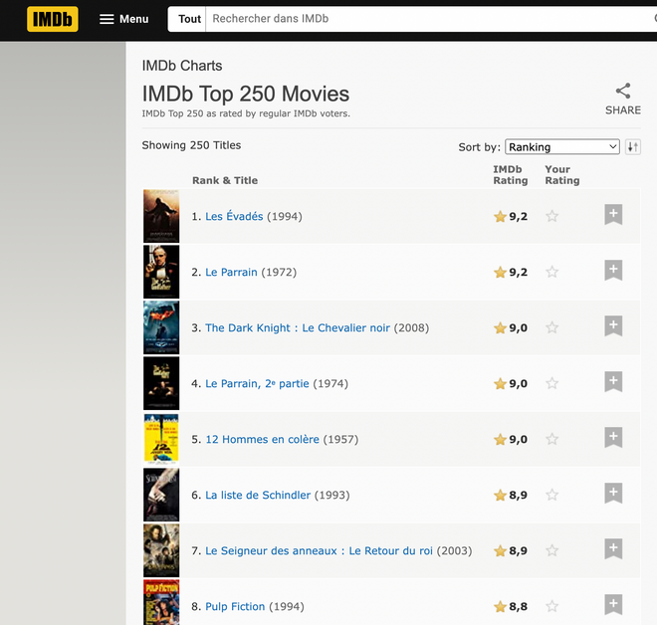


Data sources and data work
IMBD site
IMBD : We scraped the top 250 movies from this site
Allociné : We scraped the list of the most famous actors on the Allociné site
IMBD : We scraped the data of the upcoming movie releases on the IMBD website in order to predict their rating based on success factors such as genre, director or actors
Allociné site

Slide 5
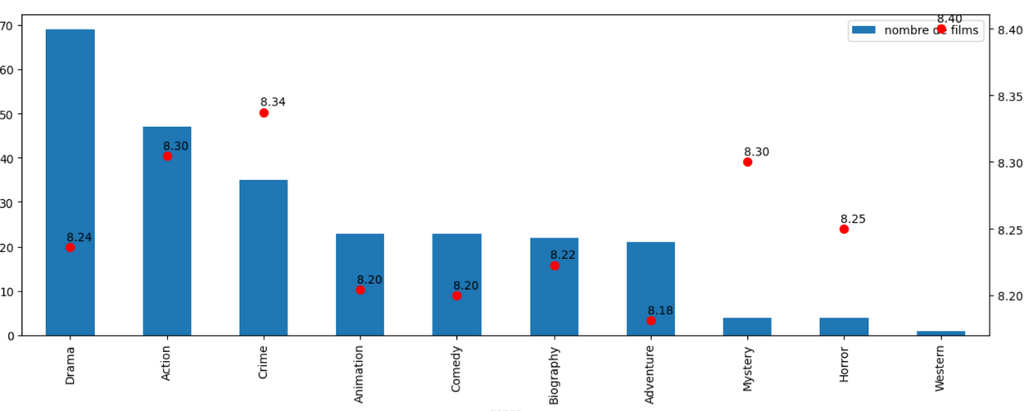
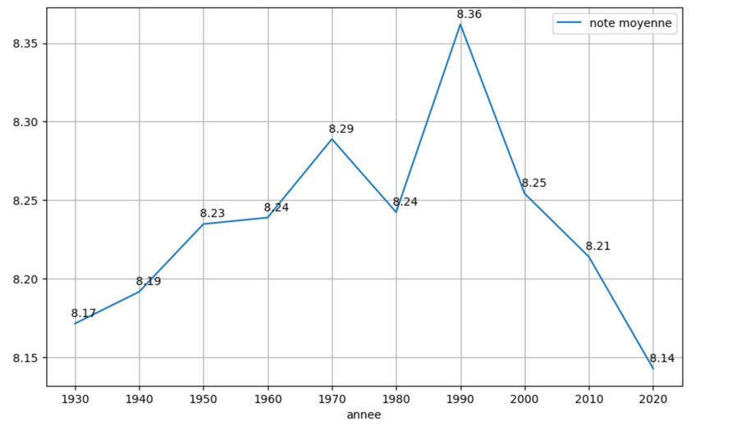
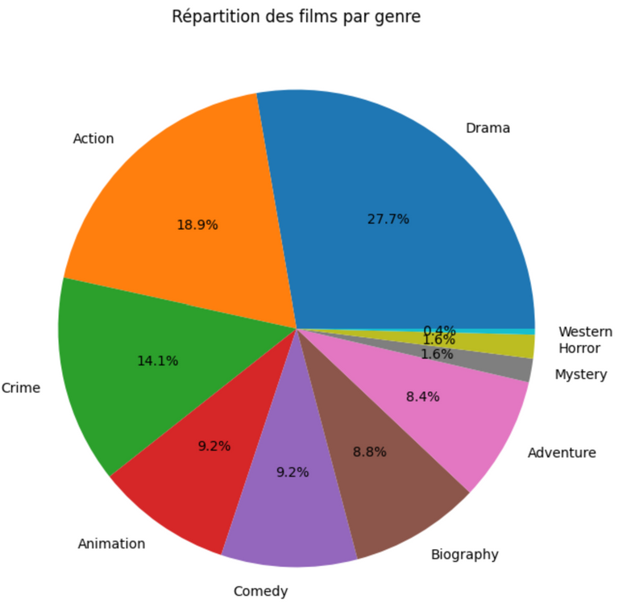
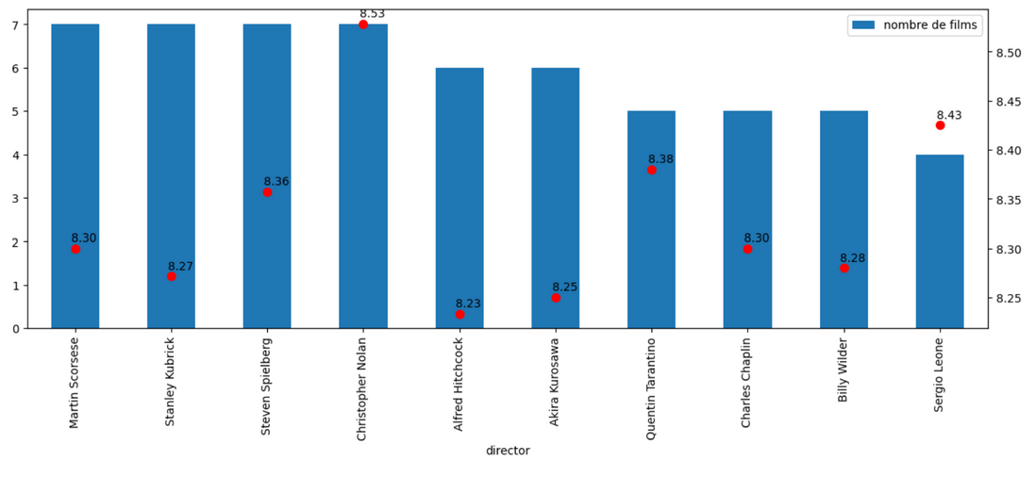
visualisation
04

Slide 6
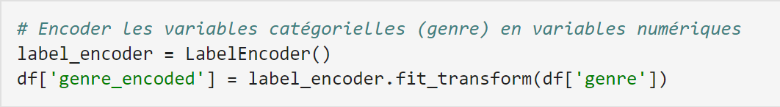
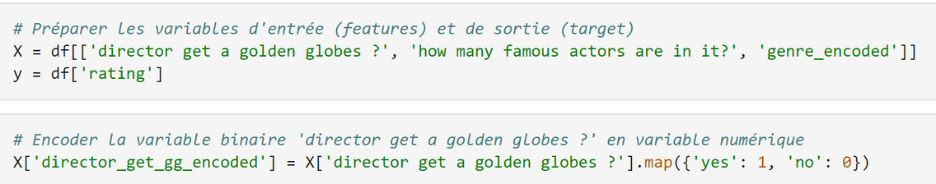
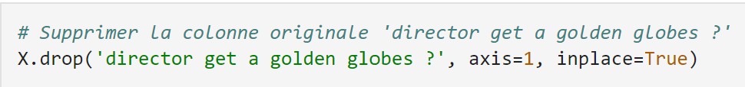
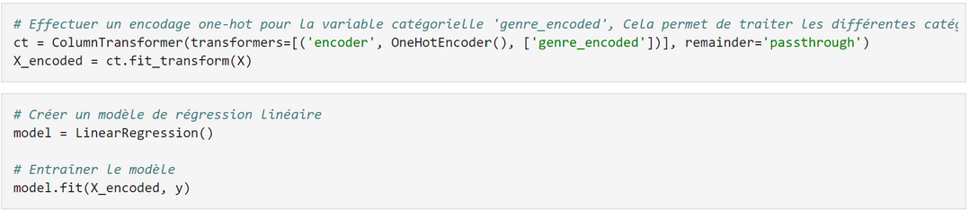
Modeling
Training : Training a linear regression model to predict the movie ratings of a complete database (top 250)
Evaluating : Evaluating the model with a test dataset
Predicting : Using the linear regression model found during the training to find the movie rating of an upcoming movie dataset in which there is no rating yet

Slide 7

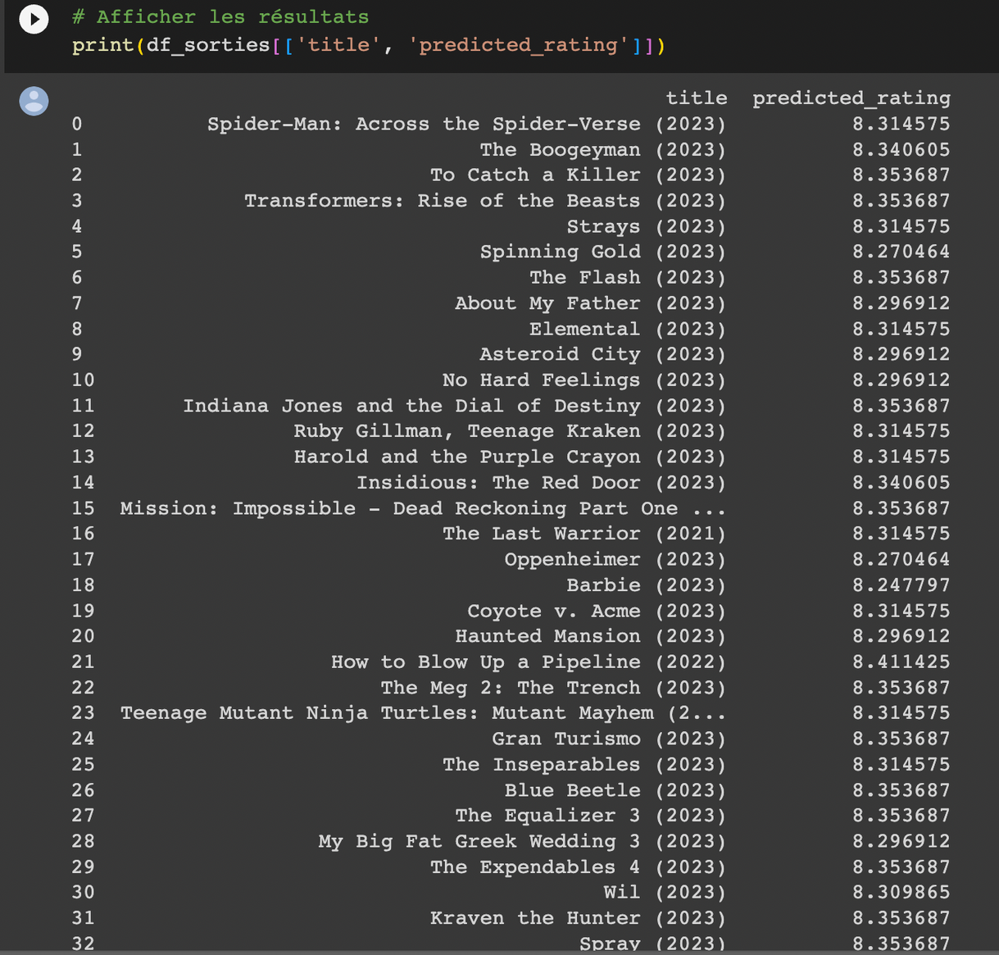
The result of our question
Can you predict the rating of upcoming movies ?

Slide 8


Conclusion
10
In conclusion, we scraped information on the top actors, the best films, and upcoming movie releases. Using this information, we were able to make progress in the visualization and modeling aspects, ultimately arriving at an answer to our research question: "Can you predict the rating of upcoming movies?".
Moreover, all three of us were novices in the skills involved. It hasn't always been easy, but we conducted research to get up to date.

